Slide 1


Slide 2


Slide 3


Slide 4

Traffic fatalities: Comparing USA to other countries provides key policy insights
Dr. Leonard Evans
President, Science Serving Society
Member, National Academy of Engineering
President-Emeritus, ITMA
973 Satterlee Rd.
Bloomfield Hills
Michigan, USA
ITMA 27 Sept. 15-17 2026
Devoted to adding reason and
knowledge to public policy
Tue. 15 Sept. 2026, 2:00-2:30pm
Notes:
Good to see everybody here
An intellectual is a person who has discovered something more interesting than sex.
Aldous Huxley

Slide 5
Notes:
Good to see everybody here
An intellectual is a person who has discovered something more interesting than sex.
Aldous Huxley

Slide 6

2014 (2011 data)

Slide 7

2014 (2011 data)
EDITORIAL
Twenty Thousand More Americas Killed Annually Because US Traffic-Safety Policy Rejects Science

Slide 8
Purpose: To contrast how USA is now performing compared to earlier study

Slide 9
Notes:
8
1972 54,589 0.357159867 0.642840133 0.569930468
2015 35,092
1972 54,589 0.723534045 0.276465955
2015 15,092
8,268 26,824 0.764390744

Slide 10
Notes:
9
1972 54,589 0.357159867 0.642840133 0.569930468
2015 35,092
1972 54,589 0.723534045 0.276465955
2015 15,092
8,268 26,824 0.764390744

Slide 11
Notes:
10
1972 54,589 0.357159867 0.642840133 0.569930468
2015 35,092
1972 54,589 0.723534045 0.276465955
2015 15,092
8,268 26,824 0.764390744

Slide 12
Notes:
11
1972 54,589 0.357159867 0.642840133 0.569930468
2015 35,092
1972 54,589 0.723534045 0.276465955
2015 15,092
8,268 26,824 0.764390744

Slide 13
Maximum value
54,589 in 1972
Notes:
12
1972 54,589 0.357159867 0.642840133 0.569930468
2015 35,092
1972 54,589 0.723534045 0.276465955
2015 15,092
8,268 26,824 0.764390744

Slide 14
Maximum value
54,589 in 1972
Notes:
13
1972 54,589 0.357159867 0.642840133 0.569930468
2015 35,092
1972 54,589 0.723534045 0.276465955
2015 15,092
8,268 26,824 0.764390744

Slide 15
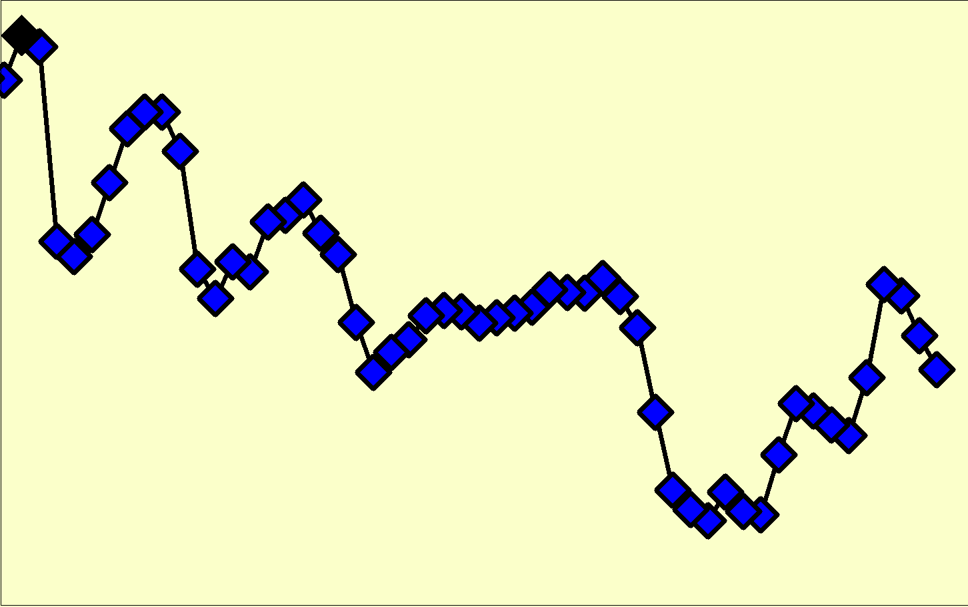
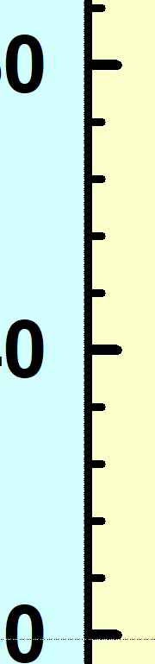

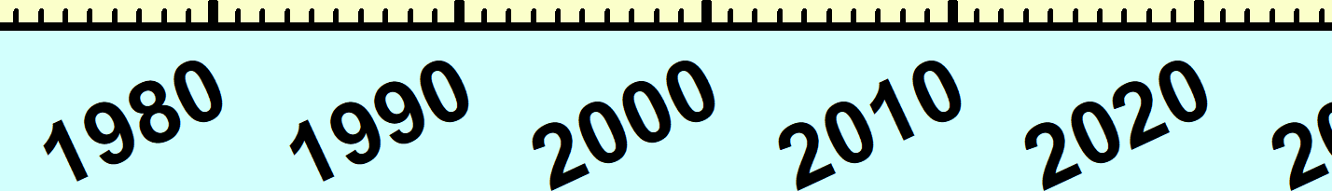

In 51 years since reaching peak,
USA fatalities declined by 25.1%
Maximum value
54,589 in 1972
40,901 road deaths in 2023
Notes:
14
1972 54,589 0.357159867 0.642840133 0.569930468
2015 35,092
1972 54,589 0.723534045 0.276465955
2015 15,092
8,268 26,824 0.764390744

Slide 16
Because fatalities reach a maximum, we can define a simple quantity:
Fatalities in a given year
Maximum yearly fatalities
100 x
 Dimensionless (no units)
 Few arbitrary assumptions
 Depends ONLY on fatalities
 Plot (on logarithm scale) how this quantity varies in time after maximum is reached
Notes:
15

Slide 17
As for 2014 paper, we use IRTAD (International Road Traffic and Accident Database)
Include same 26 countries as 2014 paper
2014 study had data up to 2011
We now have data up to 2023
So present study has 12 years later data than earlier
After passage of 12 years is USA
■ Doing better?
■ Doing about same?
■ Doing even worse?
Notes:
16
16
International Transport Forum (ITF).

Slide 18
Maximum value
54,589 in 1972
In 51 years since reaching peak,
USA fatalities declined by 25.1%
40,901 road deaths in 2023
Notes:
17
1972 54,589 0.357159867 0.642840133 0.569930468
2015 35,092
1972 54,589 0.723534045 0.276465955
2015 15,092
8,268 26,824 0.764390744

Slide 19
2023 data
74.9 % of maximum
(that is, a 25.1% reduction)
51 years after reaching maximum in 1972

Slide 20
2023 data

Slide 21
2023 data

Slide 22
2023 data

Slide 23
2023 data

Slide 24
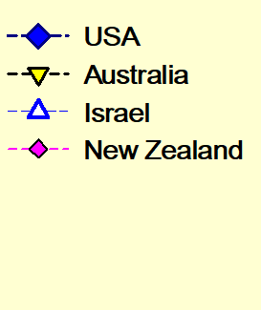
2023 data
These 3 countries reduced road deaths
by more than ~50% but less than 70%

Slide 25
2023 data

Slide 26
2023 data

Slide 27
2023 data

Slide 28
2023 data

Slide 29
2023 data

Slide 30
2023 data

Slide 31
2023 data

Slide 32
These 7 countries reduced road deaths
by more than 70% but less than 80%
25

Slide 33
2023 data

Slide 34
2023 data

Slide 35
2023 data

Slide 36
2023 data

Slide 37
2023 data

Slide 38
2023 data

Slide 39
2023 data

Slide 40
2023 data

Slide 41
2023 data

Slide 42
2023 data

Slide 43
These 10 countries reduced road deaths
by more than 80% but less than 85%

Slide 44
2023 data

Slide 45
2023 data

Slide 46
2023 data

Slide 47
2023 data

Slide 48
2023 data

Slide 49
These 5 countries reduced road deaths
by more than 85%

Slide 50
2023 data

Slide 51
2023 data

Slide 52
Example - Japan
Notes:
51
1972 54,589 0.357159867 0.642840133 0.569930468
2015 35,092
1972 54,589 0.723534045 0.276465955
2015 15,092
8,268 26,824 0.764390744

Slide 53
Example - Japan
 | Japan | USA
Max fatalities | 21,795 | 54,580
(occurred in) | (1970) | (1972)
2023 fatalities | 3,263 | 40,901
reduction | 85.0% | 25.1%
US fatalities if US had 85.0% reduction like Japan |  | 8,171
Actual US fatalities |  | 40,901
US extra fatalities due to not matching Japan |  | 32,730
Notes:
52
1972 54,589 0.357159867 0.642840133 0.569930468
2015 35,092
1972 54,589 0.723534045 0.276465955
2015 15,092
8,268 26,824 0.764390744

Slide 54
USA compared to Japan
 | Japan | USA
Max fatalities | 21,795 | 54,589
(occurred in) | (1970) | (1972)
2023 fatalities | 3,263 | 40,901
reduction | 85.0% | 25.1%
US fatalities if US had 85.0% reduction like Japan |  | 8,171
Actual US fatalities |  | 40,901
US extra fatalities due to not matching Japan |  | 32,730
Notes:
53
1972 54,589 0.357159867 0.642840133 0.569930468
2015 35,092
1972 54,589 0.723534045 0.276465955
2015 15,092
8,268 26,824 0.764390744

Slide 55
USA compared to Japan
 | Japan | USA
Max fatalities | 21,795 | 54,589
(occurred in) | (1970) | (1972)
2023 fatalities | 3,263 | 40,901
reduction | 85.0% | 25.1%
US fatalities if US had 85.0% reduction like Japan |  | 8,172
Notes:
54
1972 54,589 0.357159867 0.642840133 0.569930468
2015 35,092
1972 54,589 0.723534045 0.276465955
2015 15,092
8,268 26,824 0.764390744

Slide 56
USA compared to Japan
 | Japan | USA
Max fatalities | 21,795 | 54,580
(occurred in) | (1970) | (1972)
2023 fatalities | 3,263 | 40,901
reduction | 85.0% | 25.1%
US fatalities if US had 85.0% reduction like Japan |  | 8,172
Actual US fatalities |  | 40,901
Notes:
55
1972 54,589 0.357159867 0.642840133 0.569930468
2015 35,092
1972 54,589 0.723534045 0.276465955
2015 15,092
8,268 26,824 0.764390744

Slide 57
USA compared to Japan
 | Japan | USA
Max fatalities | 21,795 | 54,580
(occurred in) | (1970) | (1972)
2023 fatalities | 3,263 | 40,901
reduction | 85.0% | 25.1%
US fatalities if US had 85.0% reduction like Japan |  | 8,172
Actual US fatalities |  | 40,901
US extra fatalities due to not matching Japan |  | 32,729
Notes:
56
1972 54,589 0.357159867 0.642840133 0.569930468
2015 35,092
1972 54,589 0.723534045 0.276465955
2015 15,092
8,268 26,824 0.764390744

Slide 58
USA compared to average of 25 other countries
 | Average of 25 countries | USA
Max fatalities |  | 54,580
(occurred in) |  | (1972)
2023 fatalities |  | 40,901
reduction | 78.3% | 25.1%
US fatalities if US had 78.3% reduction |  | 11,838
Actual US fatalities |  | 40,901
US extra fatalities due to not matching average |  | 29,062
Notes:
57
1972 54,589 0.357159867 0.642840133 0.569930468
2015 35,092
1972 54,589 0.723534045 0.276465955
2015 15,092
8,268 26,824 0.764390744

Slide 59
USA compared to average of 25 other countries
 | Average of 25 countries | USA
Max fatalities |  | 54,580
(occurred in) |  | (1972)
2023 fatalities |  | 40,901
reduction | 78.3% | 25.1%
US fatalities if US had 78.3% reduction |  | 11,838
Actual US fatalities |  | 40,901
US extra fatalities due to not matching average |  | 29,062
Notes:
58
1972 54,589 0.357159867 0.642840133 0.569930468
2015 35,092
1972 54,589 0.723534045 0.276465955
2015 15,092
8,268 26,824 0.764390744

Slide 60
RESULT
If US was average, 29,000 fewer deaths per year on US roads
Notes:
59

Slide 61
RESULT
If US was average, 29,000 fewer deaths per year on US roads (much worse than 20,000 found in 2014 study)
Notes:
60

Slide 62
RESULT
If US was average, 29,000 fewer deaths per year on US roads (much worse than 20,000 found in 2014 study)
WHY??
Notes:
61

Slide 63
EXPLANATION
US safety policy does not simply ignore science, it aggressively goes against science
Notes:
62

Slide 64
EXPLANATION
US safety policy does not simply ignore science, it aggressively goes against science
Happens because of power of US litigation industry, unparalleled anywhere else in world
Notes:
63

Slide 65
Most basic scientific findings can be summarized as:
 Vehicle factors are important
Notes:
64
64

Slide 66
Most basic scientific findings can be summarized as:
 Vehicle factors are important, but less important than roadway factors
Notes:
65
65

Slide 67
Most basic scientific findings can be summarized as:
 Vehicle factors are important, but less important than roadway factors
 Roadway factors are important
Notes:
66
66

Slide 68
Most basic scientific findings can be summarized as:
 Vehicle factors are important, but less important than roadway factors
 Roadway factors are important, but less important than driver performance factors
Notes:
67
67

Slide 69
Most basic scientific findings can be summarized as:
 Vehicle factors are important, but less important than roadway factors
 Roadway factors are important, but less important than driver performance factors
 Driver performance factors are important
Notes:
68
68

Slide 70
Most basic scientific findings can be summarized as:
 Vehicle factors are important, but less important than roadway factors
 Roadway factors are important, but less important than driver performance factors
 Driver performance factors are important, but far less important than driver behavior factors
Notes:
69
69

Slide 71
National Highway Traffic Safety Administration
would be better named the
Notes:
70

Slide 72
National Highway Traffic Safety Administration
would be better named the
National Vehicle Safety Administration
Notes:
71

Slide 73
National Highway Traffic Safety Administration
would be better named the
National Vehicle Safety Administration
“The net effect of NHTSA is to increase the number of US road deaths”. (quote from my 2014 paper)
Notes:
72

Slide 74
My recipe to reduce traffic harm is:
Notes:
73

Slide 75
My recipe to reduce traffic harm is:
Sensible traffic safety policy sensibly enforced
Notes:
74

Slide 76
CONCLUSION
Do not do same as USA
Notes:
75

Slide 77
CONCLUSION
Do not do same as USA
 Instead develop interventions that produce greatest reductions in harm
Notes:
76

Slide 78
CONCLUSION
Do not do same as USA
 Instead develop interventions that produce greatest reductions in harm
 Speed is central
Notes:
77

Slide 82
Two large-scale investigations from 1970s
 One in USA supported by NHTSA
 Other in UK conducted by UK government
Notes:
81

Slide 83
1970s
NHTSA funded study of factors associated with ~ 5,000 crashes
Notes:
82

Slide 84
1970s
UK conducted study of factors associated with ~ 5,000 crashes
Notes:
83

Slide 85
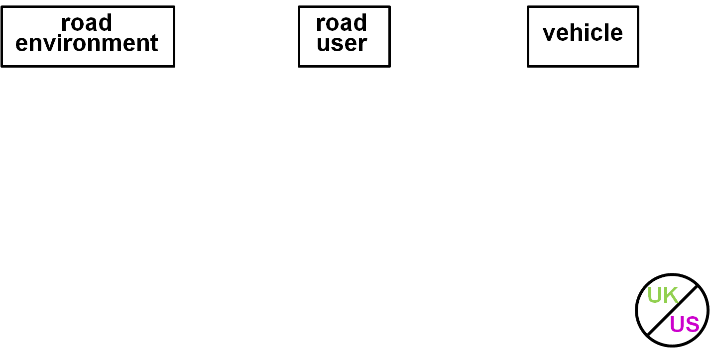
Notes:
84

Slide 86
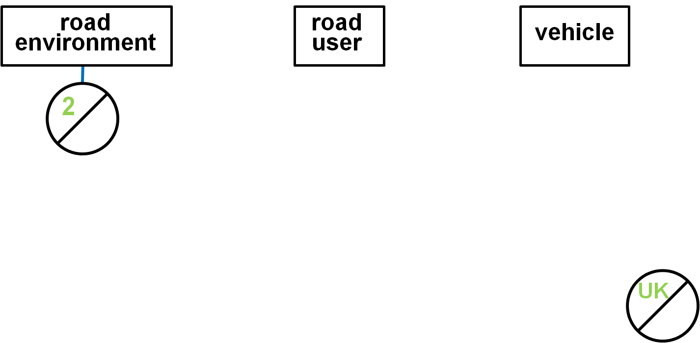
Notes:
85

Slide 87
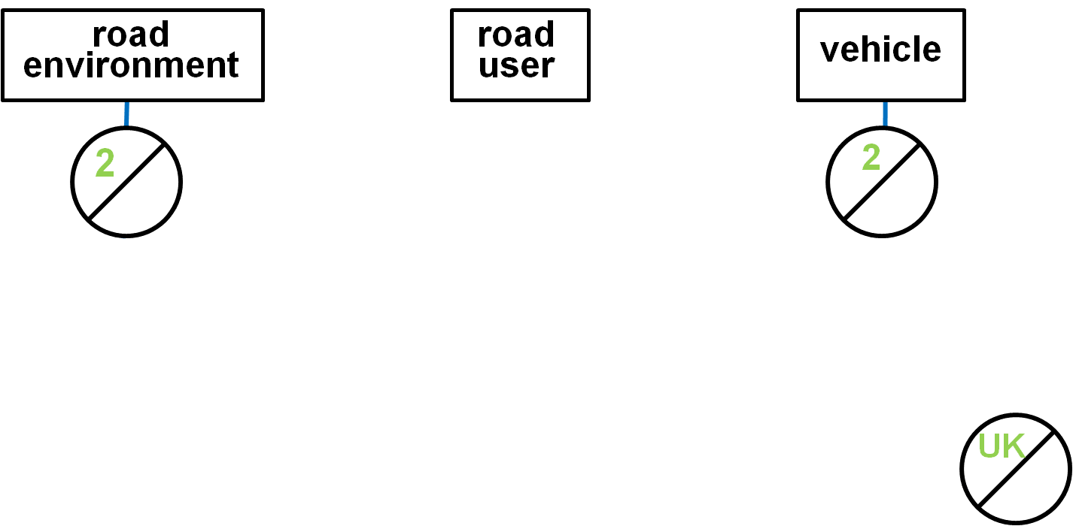
Notes:
86

Slide 88
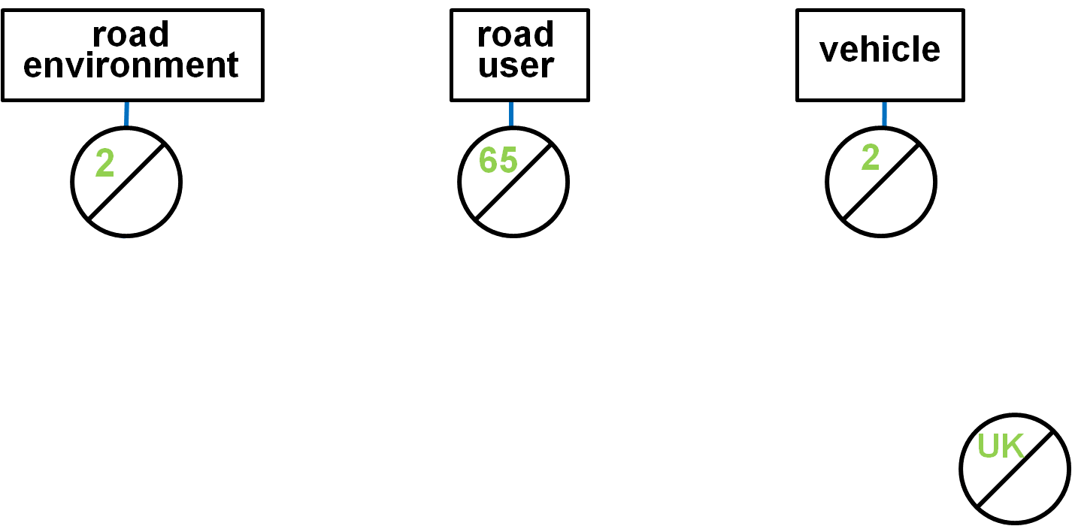
Notes:
87

Slide 89
Notes:
88

Slide 90
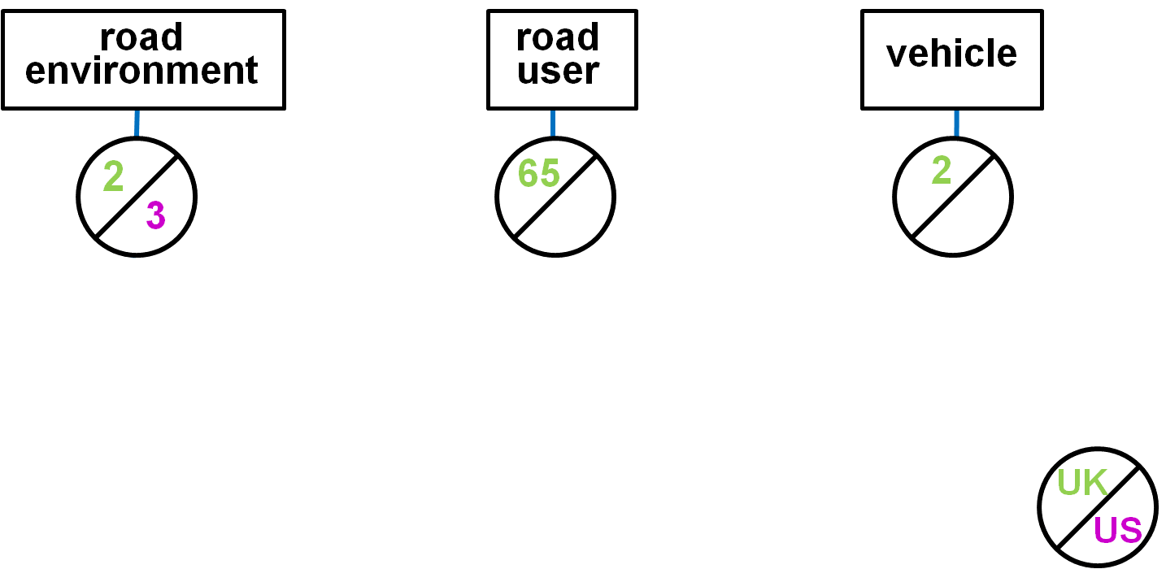
Notes:
89

Slide 91

Notes:
90

Slide 92

Notes:
91

Slide 93
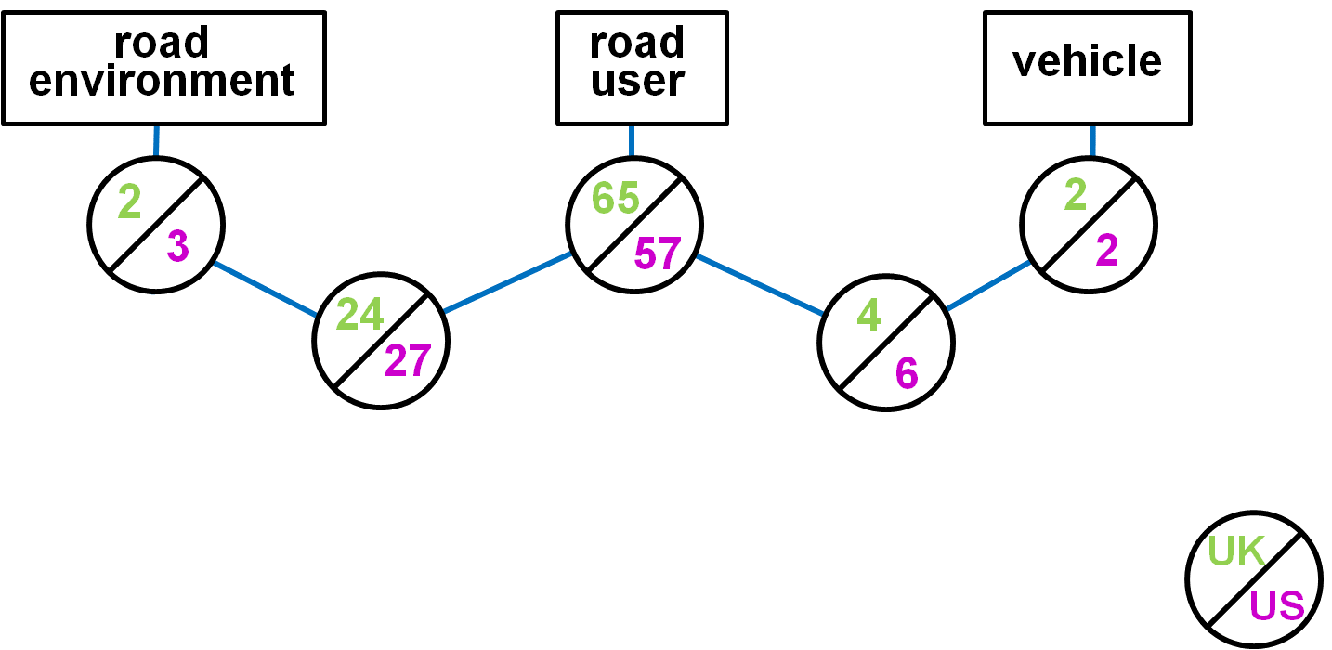
Notes:
92

Slide 94
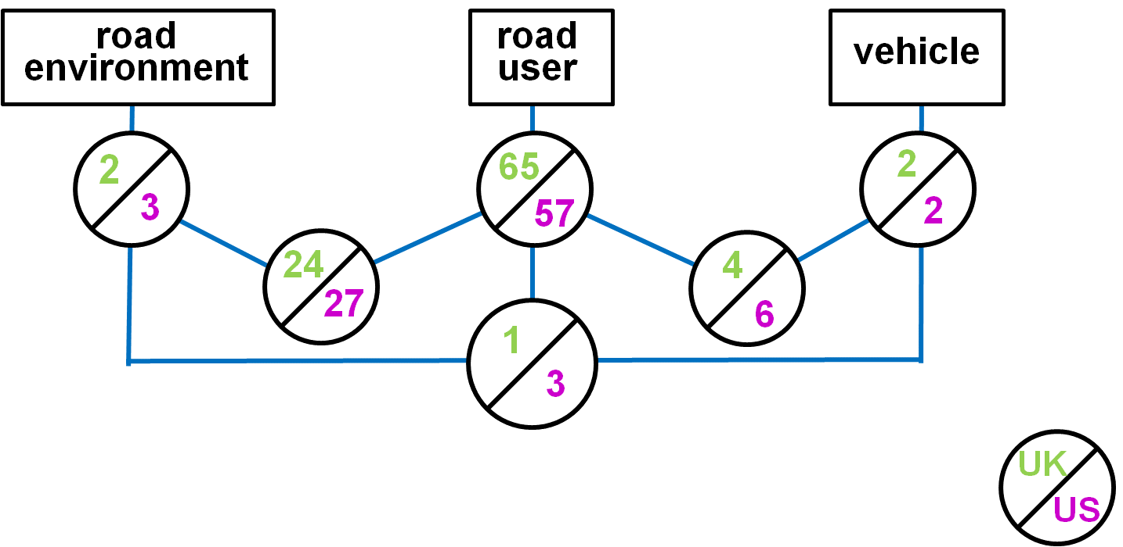
Notes:
93

Slide 95
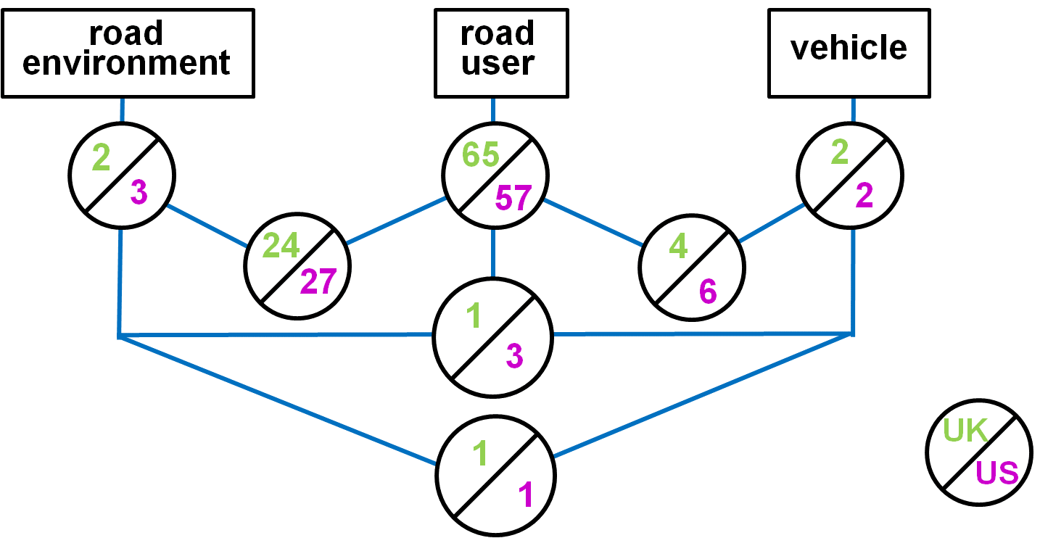
Notes:
94

Slide 96
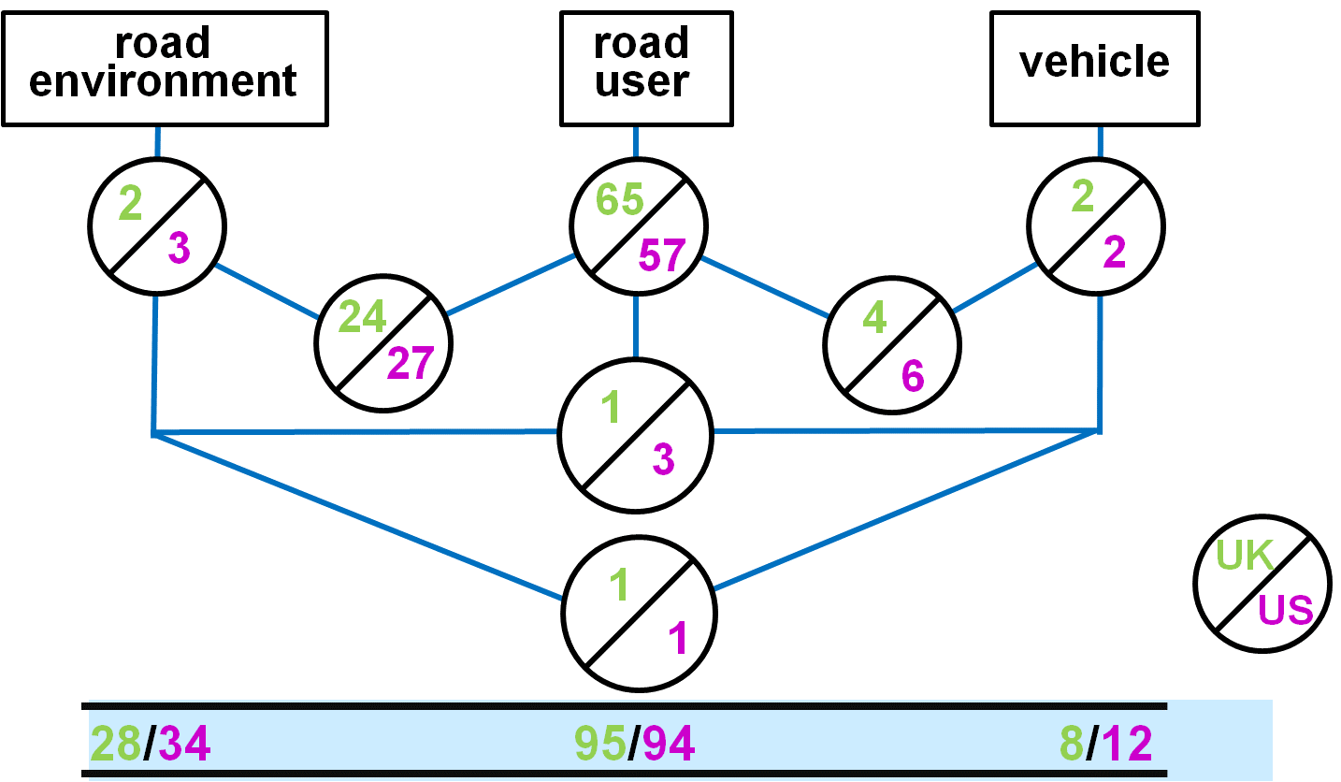

Notes:
95

Slide 97
With this, and copious additional corroborating evidence, what did US do?
Put near exclusive emphasis on vehicles (least important factor)
Happened because US policy was formulated by ideologically driven lawyers lacking knowledge or interest in science
Such leadership emerged because of the uniquely powerful influence of law on all aspects of US society
Notes:
96
96

Slide 98
National Highway Traffic Safety Administration
would be better named the
National Vehicle Safety Administration
“The net effect of NHTSA is to increase the number of US road deaths”.
Notes:
97

