Slide 1

Traffic fatalities: Comparing USA to other countries provides key policy insights
Dr. Leonard Evans
President, Science Serving Society
Member, National Academy of Engineering
President-Emeritus, ITMA
973 Satterlee Rd.
Bloomfield Hills
Michigan, USA
ITMA 27 Sept. 15-17 2026
Devoted to adding reason and
knowledge to public policy
Tue. 15 Sept. 2026, 2:00-2:30pm
Notes:
Good to see everybody here
An intellectual is a person who has discovered something more interesting than sex.
Aldous Huxley

Slide 2
Notes:
Good to see everybody here
An intellectual is a person who has discovered something more interesting than sex.
Aldous Huxley

Slide 3

2014 (2011 data)

Slide 4

2014 (2011 data)
EDITORIAL
Twenty Thousand More Americas Killed Annually Because US Traffic-Safety Policy Rejects Science

Slide 5
Purpose: To contrast how USA is now performing compared to earlier study
Notes:
4
4
International Transport Forum (ITF).

Slide 6
Notes:
5
1972 54,589 0.357159867 0.642840133 0.569930468
2015 35,092
1972 54,589 0.723534045 0.276465955
2015 15,092
8,268 26,824 0.764390744

Slide 7
Notes:
6
1972 54,589 0.357159867 0.642840133 0.569930468
2015 35,092
1972 54,589 0.723534045 0.276465955
2015 15,092
8,268 26,824 0.764390744

Slide 8
Notes:
7
1972 54,589 0.357159867 0.642840133 0.569930468
2015 35,092
1972 54,589 0.723534045 0.276465955
2015 15,092
8,268 26,824 0.764390744

Slide 9
Notes:
8
1972 54,589 0.357159867 0.642840133 0.569930468
2015 35,092
1972 54,589 0.723534045 0.276465955
2015 15,092
8,268 26,824 0.764390744

Slide 10
Maximum value
54,589 in 1972
Notes:
9
1972 54,589 0.357159867 0.642840133 0.569930468
2015 35,092
1972 54,589 0.723534045 0.276465955
2015 15,092
8,268 26,824 0.764390744

Slide 11
Maximum value
54,589 in 1972
Notes:
10
1972 54,589 0.357159867 0.642840133 0.569930468
2015 35,092
1972 54,589 0.723534045 0.276465955
2015 15,092
8,268 26,824 0.764390744

Slide 12
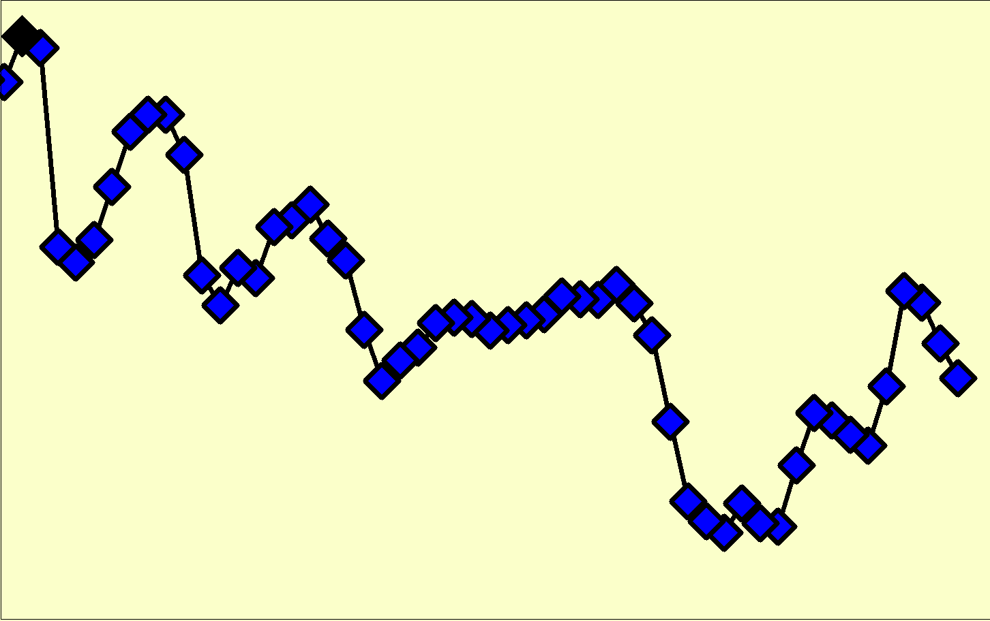
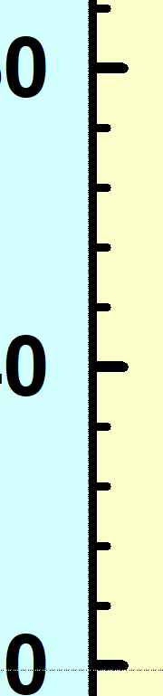

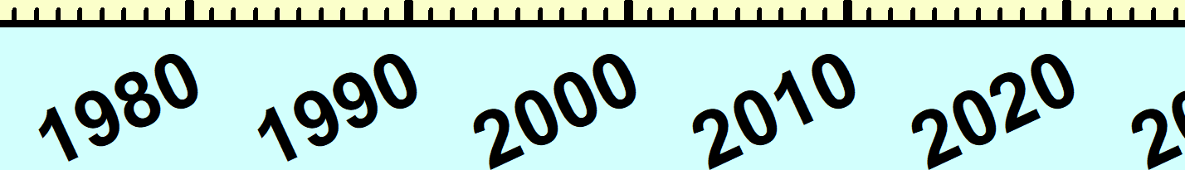

In 51 years since reaching peak,
USA fatalities declined by 25.1%
Maximum value
54,589 in 1972
40,901 road deaths in 2023
Notes:
11
1972 54,589 0.357159867 0.642840133 0.569930468
2015 35,092
1972 54,589 0.723534045 0.276465955
2015 15,092
8,268 26,824 0.764390744

Slide 13
Because fatalities reach a maximum, we can define a simple quantity:
Fatalities in a given year
Maximum yearly fatalities
100 x
 Dimensionless (no units)
 Few arbitrary assumptions
 Depends ONLY on fatalities
 Plot (on logarithm scale) how this quantity varies in time after maximum is reached
Notes:
12

Slide 14
As for 2014 paper, we use IRTAD (International Road Traffic and Accident Database)
Include same 26 countries as 2014 paper
2014 study had data up to 2011
We now have data up to 2023
So present study has 12 years later data than earlier
After passage of 12 years is USA
■ Doing better?
■ Doing about same?
■ Doing even worse?
Notes:
13
13
International Transport Forum (ITF).

Slide 15
Maximum value
54,589 in 1972
In 51 years since reaching peak,
USA fatalities declined by 25.1%
40,901 road deaths in 2023
Notes:
14
1972 54,589 0.357159867 0.642840133 0.569930468
2015 35,092
1972 54,589 0.723534045 0.276465955
2015 15,092
8,268 26,824 0.764390744

Slide 16
2023 data
74.9 % of maximum
(that is, a 25.1% reduction)
51 years after reaching maximum in 1972

Slide 17
2023 data

Slide 18
2023 data

Slide 19
2023 data

Slide 20
2023 data

Slide 21
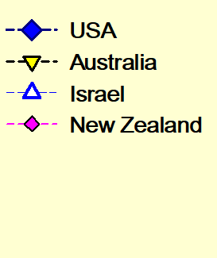
2023 data
These 3 countries reduced road deaths
by more than ~50% but less than 70%

Slide 22
2023 data

Slide 23
2023 data

Slide 24
2023 data

Slide 25
2023 data

Slide 26
2023 data

Slide 27
2023 data

Slide 28
2023 data

Slide 29
These 7 countries reduced road deaths
by more than 70% but less than 80%
25

Slide 30
2023 data

Slide 31
2023 data

Slide 32
2023 data

Slide 33
2023 data

Slide 34
2023 data

Slide 35
2023 data

Slide 36
2023 data

Slide 37
2023 data

Slide 38
2023 data

Slide 39
2023 data

Slide 40
These 10 countries reduced road deaths
by more than 80% but less than 85%

Slide 41
2023 data

Slide 42
2023 data

Slide 43
2023 data

Slide 44
2023 data

Slide 45
2023 data

Slide 46
These 5 countries reduced road deaths
by more than 85%

Slide 47
2023 data

Slide 48
2023 data

Slide 49
Example - Japan
Notes:
48
1972 54,589 0.357159867 0.642840133 0.569930468
2015 35,092
1972 54,589 0.723534045 0.276465955
2015 15,092
8,268 26,824 0.764390744

Slide 50
Example - Japan
 | Japan | USA
Max fatalities | 21,795 | 54,580
(occurred in) | (1970) | (1972)
2023 fatalities | 3,263 | 40,901
reduction | 85.0% | 25.1%
US fatalities if US had 85.0% reduction like Japan |  | 8,171
Actual US fatalities |  | 40,901
US extra fatalities due to not matching Japan |  | 32,730
Notes:
49
1972 54,589 0.357159867 0.642840133 0.569930468
2015 35,092
1972 54,589 0.723534045 0.276465955
2015 15,092
8,268 26,824 0.764390744

Slide 51
USA compared to Japan
 | Japan | USA
Max fatalities | 21,795 | 54,589
(occurred in) | (1970) | (1972)
2023 fatalities | 3,263 | 40,901
reduction | 85.0% | 25.1%
US fatalities if US had 85.0% reduction like Japan |  | 8,171
Actual US fatalities |  | 40,901
US extra fatalities due to not matching Japan |  | 32,730
Notes:
50
1972 54,589 0.357159867 0.642840133 0.569930468
2015 35,092
1972 54,589 0.723534045 0.276465955
2015 15,092
8,268 26,824 0.764390744

Slide 52
USA compared to Japan
 | Japan | USA
Max fatalities | 21,795 | 54,589
(occurred in) | (1970) | (1972)
2023 fatalities | 3,263 | 40,901
reduction | 85.0% | 25.1%
US fatalities if US had 85.0% reduction like Japan |  | 8,172
Notes:
51
1972 54,589 0.357159867 0.642840133 0.569930468
2015 35,092
1972 54,589 0.723534045 0.276465955
2015 15,092
8,268 26,824 0.764390744

Slide 53
USA compared to Japan
 | Japan | USA
Max fatalities | 21,795 | 54,580
(occurred in) | (1970) | (1972)
2023 fatalities | 3,263 | 40,901
reduction | 85.0% | 25.1%
US fatalities if US had 85.0% reduction like Japan |  | 8,172
Actual US fatalities |  | 40,901
Notes:
52
1972 54,589 0.357159867 0.642840133 0.569930468
2015 35,092
1972 54,589 0.723534045 0.276465955
2015 15,092
8,268 26,824 0.764390744

Slide 54
USA compared to Japan
 | Japan | USA
Max fatalities | 21,795 | 54,580
(occurred in) | (1970) | (1972)
2023 fatalities | 3,263 | 40,901
reduction | 85.0% | 25.1%
US fatalities if US had 85.0% reduction like Japan |  | 8,172
Actual US fatalities |  | 40,901
US extra fatalities due to not matching Japan |  | 32,729
Notes:
53
1972 54,589 0.357159867 0.642840133 0.569930468
2015 35,092
1972 54,589 0.723534045 0.276465955
2015 15,092
8,268 26,824 0.764390744

Slide 55
USA compared to average of 25 other countries
 | Average of 25 countries | USA
Max fatalities |  | 54,580
(occurred in) |  | (1972)
2023 fatalities |  | 40,901
reduction | 78.3% | 25.1%
US fatalities if US had 78.3% reduction |  | 11,838
Actual US fatalities |  | 40,901
US extra fatalities due to not matching average |  | 29,062
Notes:
54
1972 54,589 0.357159867 0.642840133 0.569930468
2015 35,092
1972 54,589 0.723534045 0.276465955
2015 15,092
8,268 26,824 0.764390744

Slide 56
USA compared to average of 25 other countries
 | Average of 25 countries | USA
Max fatalities |  | 54,580
(occurred in) |  | (1972)
2023 fatalities |  | 40,901
reduction | 78.3% | 25.1%
US fatalities if US had 78.3% reduction |  | 11,838
Actual US fatalities |  | 40,901
US extra fatalities due to not matching average |  | 29,062
Notes:
55
1972 54,589 0.357159867 0.642840133 0.569930468
2015 35,092
1972 54,589 0.723534045 0.276465955
2015 15,092
8,268 26,824 0.764390744

Slide 57
RESULT
If US was average, 29,000 fewer deaths per year on US roads
Notes:
56

Slide 58
RESULT
If US was average, 29,000 fewer deaths per year on US roads (much worse than 20,000 found in 2014 study)
Notes:
57

Slide 59
RESULT
If US was average, 29,000 fewer deaths per year on US roads (much worse than 20,000 found in 2014 study)
WHY??
Notes:
58

Slide 60
EXPLANATION
US safety policy does not simply ignore science, it aggressively goes against science
Notes:
59

Slide 61
EXPLANATION
US safety policy does not simply ignore science, it aggressively goes against science
Happens because of power of US litigation industry, unparalleled anywhere else in world
Notes:
60

Slide 62
Most basic scientific findings can be summarized as:
 Vehicle factors are important
Notes:
61
61

Slide 63
Most basic scientific findings can be summarized as:
 Vehicle factors are important, but less important than roadway factors
Notes:
62
62

Slide 64
Most basic scientific findings can be summarized as:
 Vehicle factors are important, but less important than roadway factors
 Roadway factors are important
Notes:
63
63

Slide 65
Most basic scientific findings can be summarized as:
 Vehicle factors are important, but less important than roadway factors
 Roadway factors are important, but less important than driver performance factors
Notes:
64
64

Slide 66
Most basic scientific findings can be summarized as:
 Vehicle factors are important, but less important than roadway factors
 Roadway factors are important, but less important than driver performance factors
 Driver performance factors are important
Notes:
65
65

Slide 67
Most basic scientific findings can be summarized as:
 Vehicle factors are important, but less important than roadway factors
 Roadway factors are important, but less important than driver performance factors
 Driver performance factors are important, but far less important than driver behavior factors
Notes:
66
66

Slide 68
National Highway Traffic Safety Administration
would be better named the
Notes:
67

Slide 69
National Highway Traffic Safety Administration
would be better named the
National Vehicle Safety Administration
Notes:
68

Slide 70
National Highway Traffic Safety Administration
would be better named the
National Vehicle Safety Administration
“The net effect of NHTSA is to increase the number of US road deaths”. (quote from my 2014 paper)
Notes:
69

Slide 71
My recipe to reduce traffic harm is:
Notes:
70

Slide 72
My recipe to reduce traffic harm is:
Sensible traffic safety policy sensibly enforced
Notes:
71

Slide 73
CONCLUSION
Do not do same as USA
Notes:
72

Slide 74
CONCLUSION
Do not do same as USA
 Instead develop interventions that produce greatest reductions in harm
Notes:
73

Slide 75
CONCLUSION
Do not do same as USA
 Instead develop interventions that produce greatest reductions in harm
 Speed is central
Notes:
74

